Slide 1

Bayesian Classifiers In Numeric Domains
JEROME FLEISCHMAN AND ISAAC ATTUAH

Slide 2
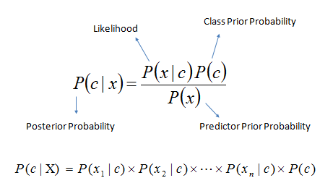
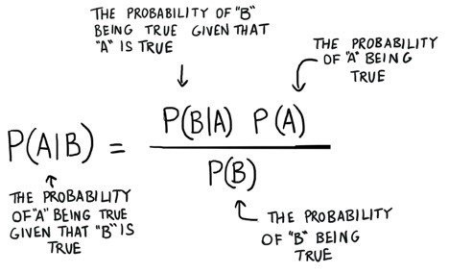
Bayesian Classifiers

Slide 3
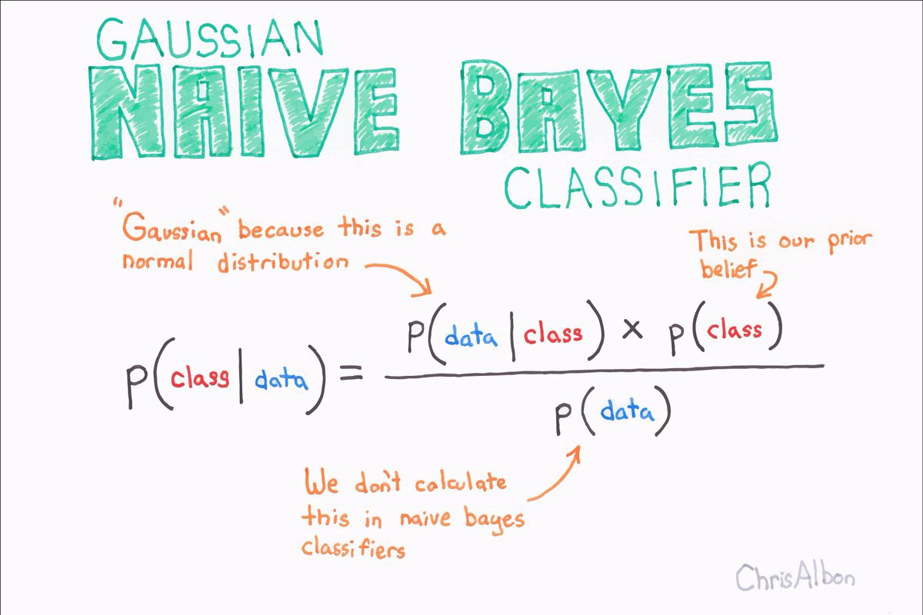
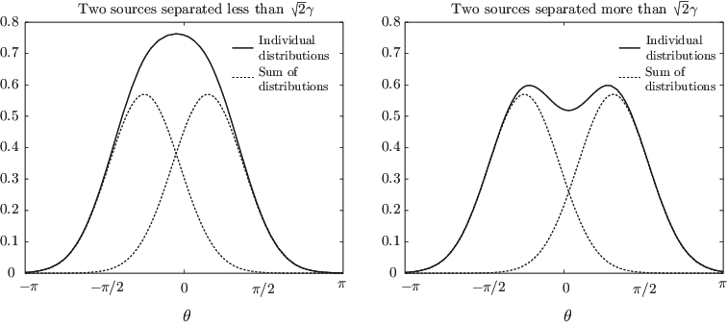
Types of Bayesian Classifiers
KERNEL FUNCTIONS CLASSIFIER

Slide 4
Goal
Explore the behavior of the Bayesian classifier using three domains from the UCI repository
Compare performance of normal distributions vs kernel functions (sum of Bayesians)
Deduce why one is better than the other

Slide 5
Use Cases
Mark email as spam or not spam
Classify a news articles based on category
Check a piece of text expressing positive emotions, or negative emotions?
Face Recognition Software

Slide 6
Procedure
Weekend
Selected domains from UCI
Monday
Research on Python and Jupyter Notebook
Wednesday
Build the model and test domains
Friday
Finished slides and report

Slide 7

Stocks

Slide 8

Observations
Dow Jones Index

Slide 9
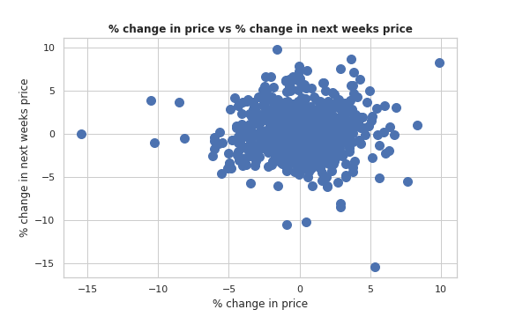
Attributes
Open
High
Low
Close
% change in price
% change in next weeks price

Slide 10
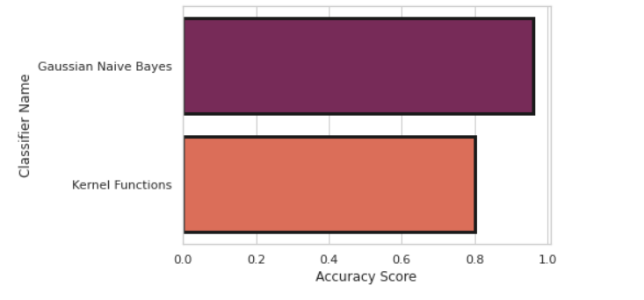
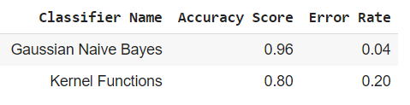
Observation

Slide 11
Reasons

Slide 12

Absenteeism at Work

Slide 13
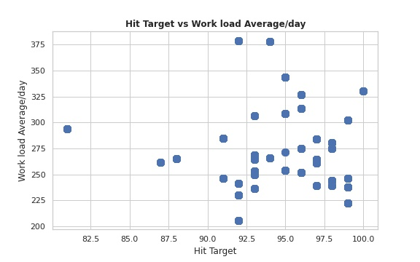
Attributes
ID
Day of the week
Weight
Height
Hit Target
Work-Load Average / Day

Slide 14
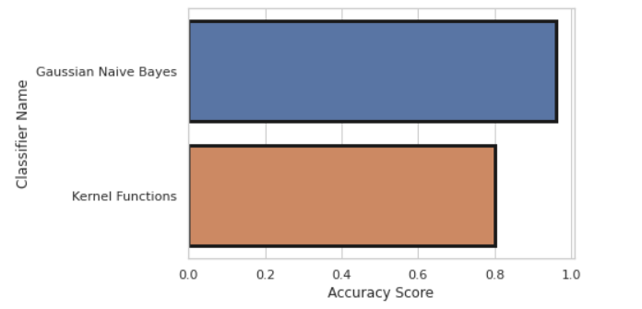
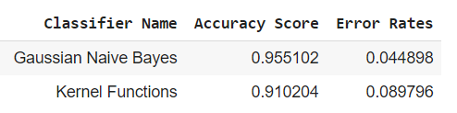
Observations

Slide 15
Reasons

Slide 16

Iris

Slide 17
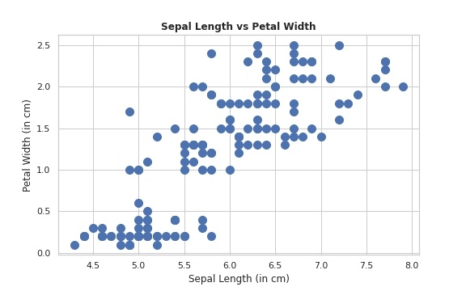
Attributes
Sepal Length
Sepal Width
Petal Length
Petal Width
Class

Slide 18
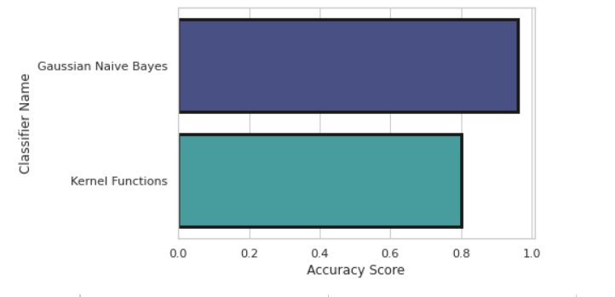
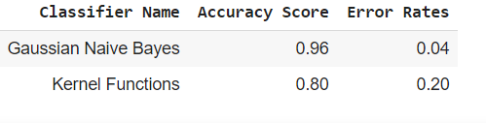
Observations

Slide 19
Reasons

Slide 20
Takeaways

Slide 21
Questions ?

